Slide 1
Grind & Crumb
☕
Build a bolder future just like coffee...

Slide 2
Our approach: split, then combine
1. Prepare: clean and join every file into one database (12 stores, July 2025 to June 2026).
💷
2a. Finance and network
🏪
2b. Store operations
💬
2c. Customers and digital
DATA
DATA
DATA
Daily sales, store costs, delivery fees, lease terms, candidate sites.
Staff rotas, turnover, waste log, footfall, weather.
3,030 reviews, surveys, interviews, platform emails, news.
QUESTION
QUESTION
QUESTION
Where do we make and lose money?
Do labour, food and queues help or hurt profit?
What do customers and staff say, and how is the app doing?
3. Aggregate: merge the three views into one list of problems, each with a root cause and a £ impact.

Slide 3
All problems and root causes
PROBLEM
SEEN IN
ROOT CAUSE
🛵
Delivery
💷💬
Commission accepted; no minimum order or price
📱
The app
💷💬
Shipped untested; tracked downloads, not orders
🥛
Oat milk fee
💷💬
Never tested; a rival dropped its fee
🏢
Manchester Piccadilly
💷🏪
£37k a month rent; judged on size, not profit
🏪
Leeds
💷🏪
Trinity opened 0.4 miles away; no overlap check
🗑️
Waste and stockouts
🏪💬
One ordering rule for every store
👥
Lunch crush and turnover
🏪💬
Hours capped flat; pay 50p below rivals
💷 Finance and network 🏪 Store operations 💬 Customers and digital

Slide 4
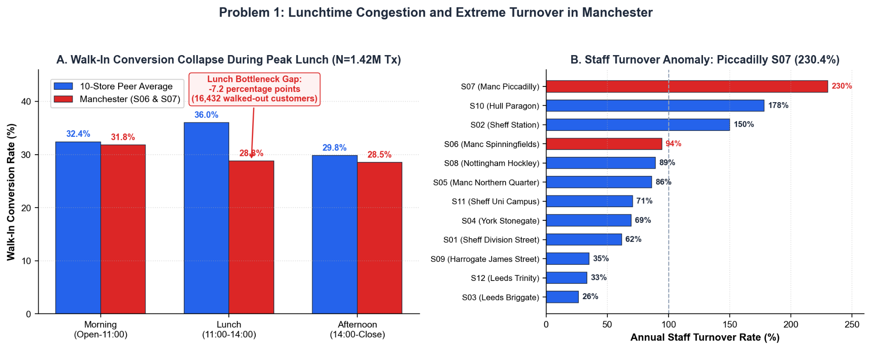
Problem 1: Lunchtime Congestion and Extreme Turnover in Manchester
🛵
OUR INVESTMENT
£165k
• High-speed coffee machine and rapid steam wands: £35,000
• Dedicated delivery packing hatch and counter separation: £40,000
• Automated dual grinders and milk dosing units: £25,000
• Queue re-routing joinery and digital order status screens: £35,000
• Staff facilities upgrade and barista retention wage reserve: £30,000
Notes:
Piccadilly sells £1.1m but loses £64k because 16,000 lunch commuters walk out of slow queues and staff turnover is 230%. Spending £165k rebuilds the service counter, adds a dedicated app pickup hatch, and gives baristas a +50p retention bonus. It pays for itself in just 14 months.

Slide 5
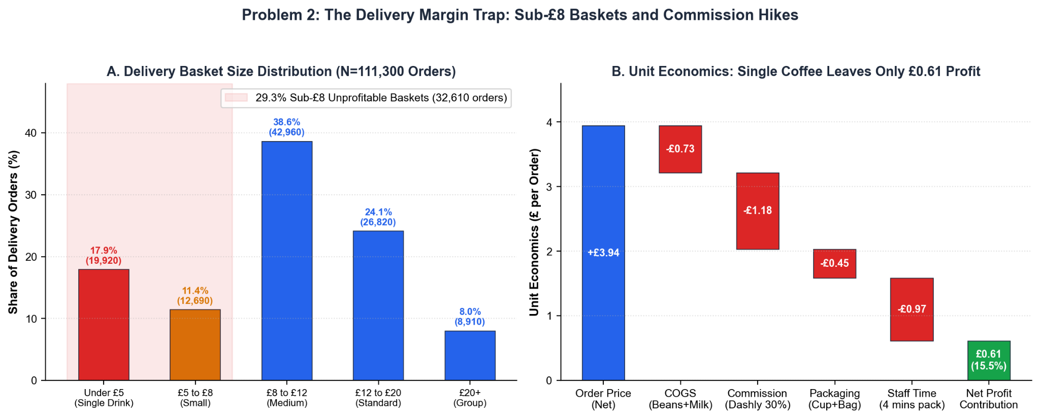
Problem 2: The Delivery Margin Trap: Sub-£8 Baskets and Commission Hikes
📱
OUR INVESTMENT
£0
• Aggregator parameter updates (£8 minimum basket rule): £0
• Channel repricing and order rerouting to RushEats: £0
Notes:
Delivery sales doubled, but nearly 30% of orders are under £8, leaving just 61p profit on a single coffee. Pushing unthrottled delivery is a trap. By setting an £8 minimum basket and shifting orders to RushEats at 30% commission, we add £82k in profit on Day 1 for zero capital expenditure.

Slide 6
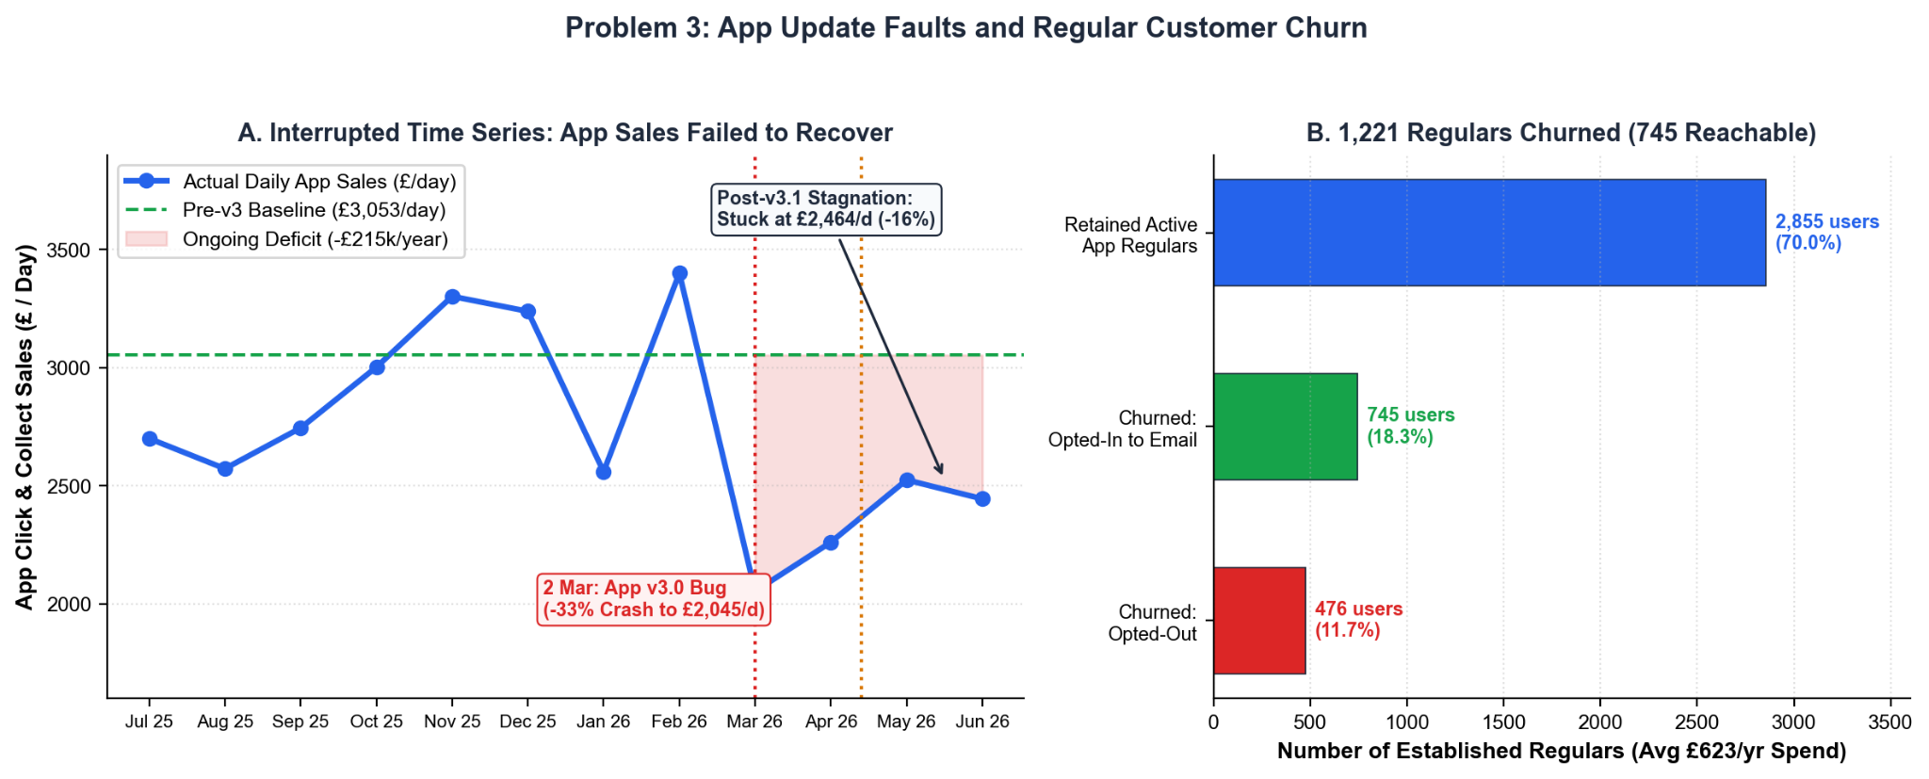
Problem 3: App Update Faults and Regular Customer Churn
🛵
OUR INVESTMENT
£165k
• Mobile application codebase rewrite and stability bug fixes: £65,000
• Payment gateway integration and checkout freeze resolution: £25,000
• Customer loyalty stamp database recovery and reconciliation: £20,000
• Targeted digital voucher credits for 745 lapsed loyalty members: £25,000
• Cloud infrastructure load testing and crash monitoring tools: £15,000
Notes:
The digital team celebrated downloads, but app sales are down -£215k/year and 1,221 of our best regulars quit when v3.0 wiped their stamps. We reject the £250k App v4 rebuild. Instead, we spend £150k to fix checkout and email our 745 reachable regulars their missing stamps plus free coffee apology tokens.

Slide 7
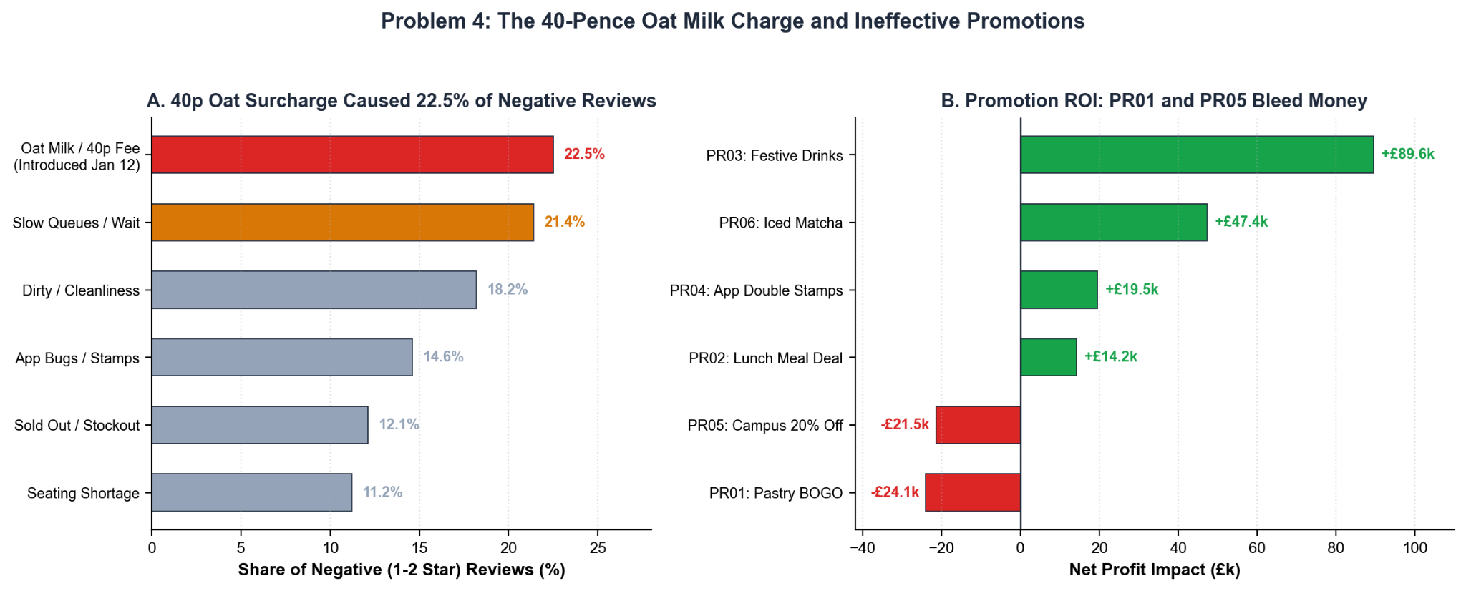
Problem 4: Surcharge Fallout, Ineffective Promotions, and Estate Standard Fatigue
🛵
OUR INVESTMENT
£220k
• Commercial espresso machines and precision grinders (2 sites): £50,000
• Seating booth upholstery and acoustic wall panels: £65,000
• Front service counter remodelling and bakery display cases: £55,000
• Ambient architectural lighting and shopfront refresh: £30,000
• Commercial water filtration and undercounter refrigeration: £20,000
Notes:
York is our #1 profit store, but it hasn't had a refit in 7 years. Harrogate serves our wealthiest customers but has weak afternoon trade. We spend £220k across both stores to protect £267k in existing profit, add 6 seats in York, and install luxury pastry displays in Harrogate to capture afternoon trade.

Slide 8
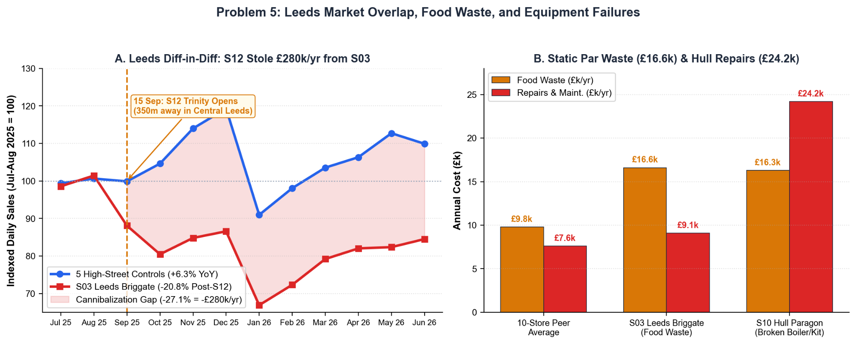
Problem 5: Leeds Market Overlap, Equipment Failures, and Food Waste
🥛
OUR INVESTMENT
£145k
• Commercial boiler replacement and heating installation (Hull S10): £28,000
• Pass-through hood dishwasher and drainage overhaul (Hull S10): £22,000
• Undercounter refrigeration and commercial ice machine (Hull S10): £15,000
• Floor space conversion into customer lounge (Leeds Briggate S03): £50,000
• Laptop workbenches, charging ports, and loose furniture (S03): £30,000
Notes:
Our data proves Leeds Trinity stole £280k from Briggate, leaving Briggate with empty back space and £16k in food waste, while Hull bled £24k on emergency repairs. Spending £145k rescues Hull's machinery and adds 16 weekend seats at Briggate, while £110k rolls out weekly P&Ls and weather-based prep tools to cut food waste chain-wide.

Slide 9
Why nobody saw the problems
WHAT THEY BELIEVED
WHAT THE DATA SHOWED
🏢
We're the biggest store, so we're the most profitable.
→
£1.11m revenue, but a yearly loss.
🏪
The city centre is just quieter this year.
→
Our own new Trinity store took sales: profit down 53%.
🗑️
We always run out, so I order extra.
→
20.7% of food wasted, against ~9.1% on average.
📱
App downloads are up 20%.
→
App share of sales fell from 14.8% to 8.5%.
Each team watched its own number. Nobody saw store profit in one place.

Slide 10
What the store health dashboard shows
💷
Store profit by month
🛵
Profit per delivery order
📱
Completed app orders
Sales minus food, waste, labour, delivery and rent.
After commission, packaging and prep time.
App share of sales and checkout failures, not downloads.
Catches: Piccadilly's loss
Catches: Small orders losing money
Catches: The v3.0 bug
👥
Peak staffing vs demand
🗑️
Waste vs sales
🏪
Nearby-store overlap
Staff on shift against 11am–2pm footfall.
Waste rate per store against the 9% benchmark.
Sales and profit of stores in the same city, side by side.
Catches: The lunch crush
Catches: Hull and Briggate
Catches: Leeds cannibalisation

Slide 11
What it would have caught early
WHAT CHANGED
WHAT THE DASHBOARD FLAGS
WHAT IT COST
Sep 2025
Briggate profit falling from £17.4k to £8.2k a month
Combined Leeds profit down 37%
Leeds Trinity opens
Dec 2025
Oat share of drinks falling from 31.6% to 23.1%
Bad reviews; rival dropped its fee
Oat milk fee starts
Mar 2026
App share down from 14.8% to 8.5% in one month
Customers moved to delivery apps
App v3.0 released
Apr 2026
Delivery profit per order shrinking
Delivery hit 22.7% of sales by June
Commission rises to 33%
Each change showed up in monthly numbers we already have.

Slide 12
What it takes
🧱
🗓️
🔓
Built on what exists
Clear owners and rhythm
Releases money on results
The cleaned database and monthly profit views are already built. The dashboard is mostly a front end on top.
Store managers check their store daily. Ops and finance review weekly. The CEO sees all 12 stores monthly.
The £300k reserve is released only if the dashboard shows delivery profit up, app share above 12% and pilot lunch sales up.
£65k to make sure the rest of the £1.5m is spent where it works.

Slide 13
What the data says
🛵
📱
🏪
🏢
Delivery
App
CS3 store
Piccadilly
£2.07m run-rate sales
Share 12.3% → 9.6%
£240k fit-out, 52k daily footfall
£446k rent a year
15% premium ≈ £100–150k a year (assumed demand loss)
≈ £246k sales a year gone elsewhere
15–20% cut ≈ £55–73k
Trinity: £385k, ~12-year payback

